Slide 1










UK Train Analysis

Slide 2


Our team
Elaph Othman
Fatma Hatem
Nadia Hesham
Noran Khattab
Mona Ahmed

Slide 3
Project Overview
Project Scope
Why it matters
Insights aimed for
Analyzing UK Rail data using Power BI and more to visualize trends and performance metrics
Optimizing rail services, improving passenger experience, and enhancing operational efficiency.
Analyzing UK Rail data using Power BI and more to visualize trends and performance metrics

Slide 4
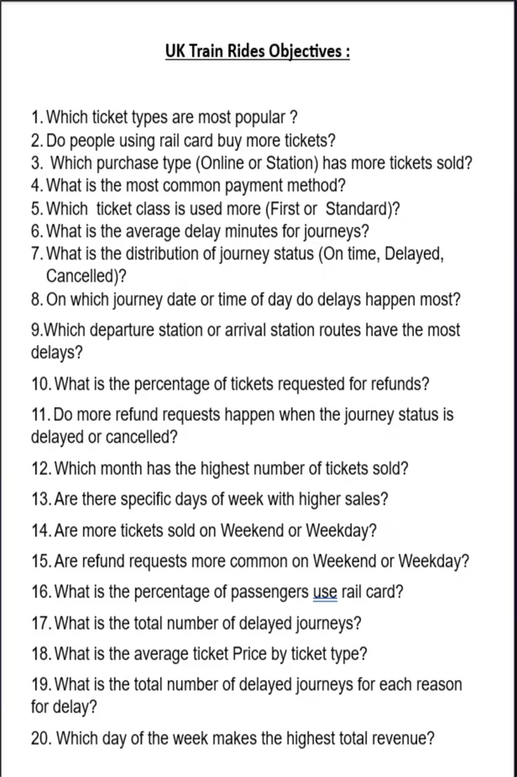
Analytical Objectives
Our analysis focused on critical aspects of UK train operations, aiming to answer key questions:
1.Most popular ticket types and rail card usage
2.Online vs. station ticket sales volume
3.Common payment methods
4.First vs. Standard class usage
5.Average delay minutes for journeys
6.Distribution of journey status (On-time, Delayed, Cancelled)
7.Peak times and routes for delays
8. Percentage of tickets requested for refunds
9. Correlation between refunds and delays/cancellations
10. Monthly and daily sales trends
11. Weekend vs. weekday sales and refunds
12. Rail card usage percentage
13. Total number of delayed journeys & reasons
14. Average ticket price by type and revenue by day

Slide 5
Source Data
link: https://www.kaggle.com/datasets/motsimaslam/national-rail-uk-train-ticket-data
Dataset Origin
Data Structure
Limitations & Notes
Data obtained from Kaggle, providing a rich source of rail operational details.
Includes various attributes such as ticket type, journey details, pricing, payment methods, and delay information.
Identified missing values in key fields, necessitating robust cleaning strategies for accurate insights.

Slide 6
Data Cleaning & Preparation
Tools used: Excel for initial review, Python for scripting, SQL for database management.
Initial Adjustments
Missing Value Handling
1
4
Calculated Delay Minutes (adjusted negative to 0) and created an Is Delayed binary flag
Filled missing Reason for Delay with 'No Delay' and actual arrival times with scheduled or 'Unknown'.
2
Journey Metrics
Date & Time Conversion
Derived Journey Duration, Purchase Day, and Journey Day for temporal analysis.
5
Converted date fields to datetimeformat and created comprehensive datetime columns for precise calculations.
Categorization
3
New Feature Engineering
Grouped ticket prices into Revenue Categories (Low, Medium, High) and simplified delay reasons.
6
Introduced Daytype of Purchase (weekday/weekend), MonthName, and Daytime (Morning/Evening) for deeper insights.

Slide 7
Power BI Dashboard
Title: UK Train Rides Dashboard Features:
Interactive Navigation: Custom UI allowing seamless transitions between specific analysis views.
Advanced KPIs: Real-time metrics for average ticket price, delays, and journey status calculated via DAX.
Trend Visualization: Clear breakdown of peak travel times and purchase methods.
Drill-Down Capability: Enables deep dives into station performance and ticket types.
Visual Summaries
1
Consolidated visuals on delays, passenger flow, revenue, and tickettype popularity )
Decision-Making Aid
2
Enables stakeholders to quickly identify areas
for operational improvement and strategic planning.
Key Insights
3
Highlights impact of peak travel times on delays and the effectiveness of different ticket classes.

Slide 8
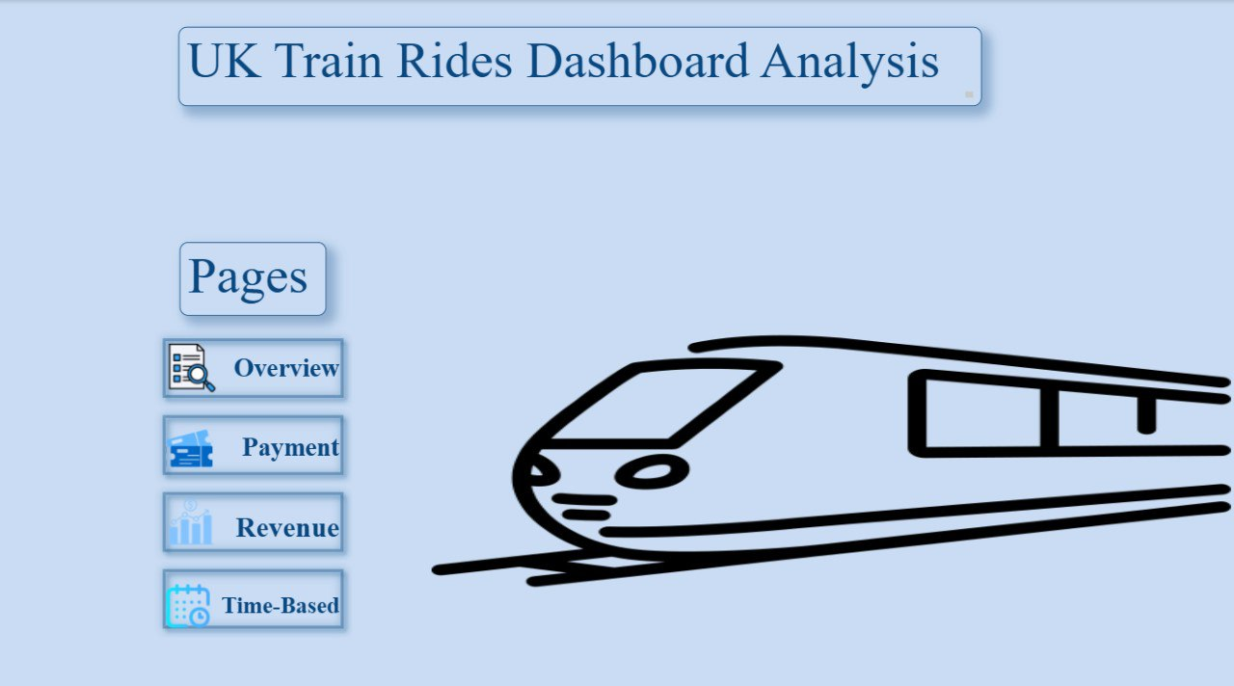
Power BI Dashboard

Slide 9
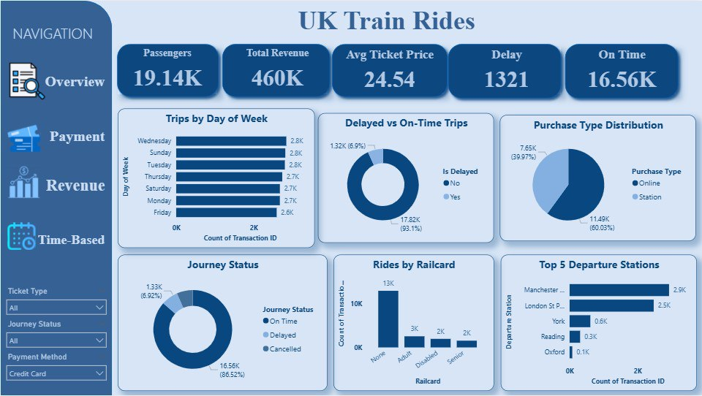
Power BI Dashboard

Slide 10
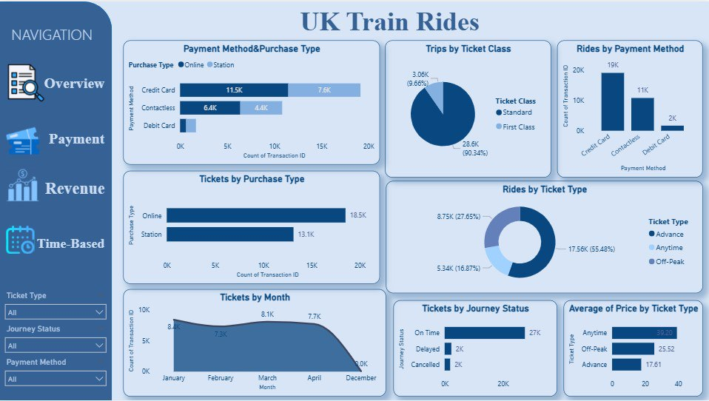
Power BI Dashboard

Slide 11
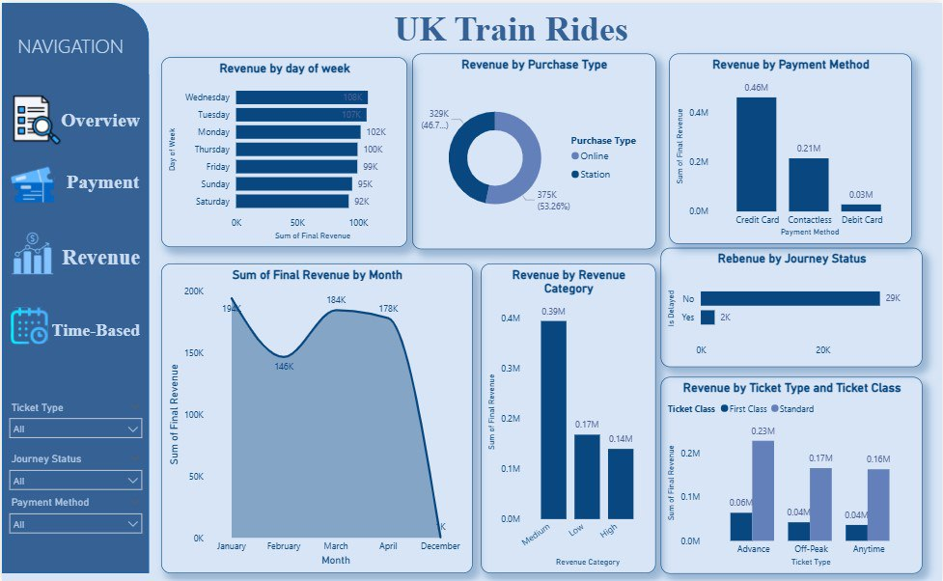
Power BI Dashboard

Slide 12
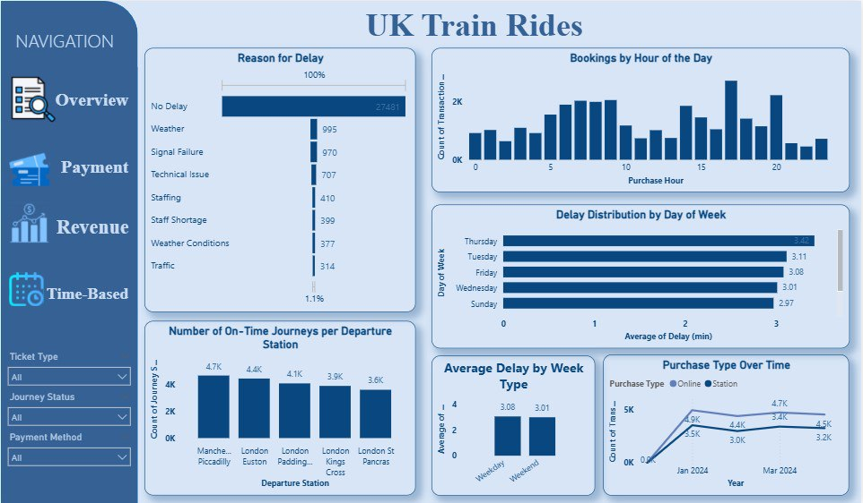
Power BI Dashboard

Slide 13
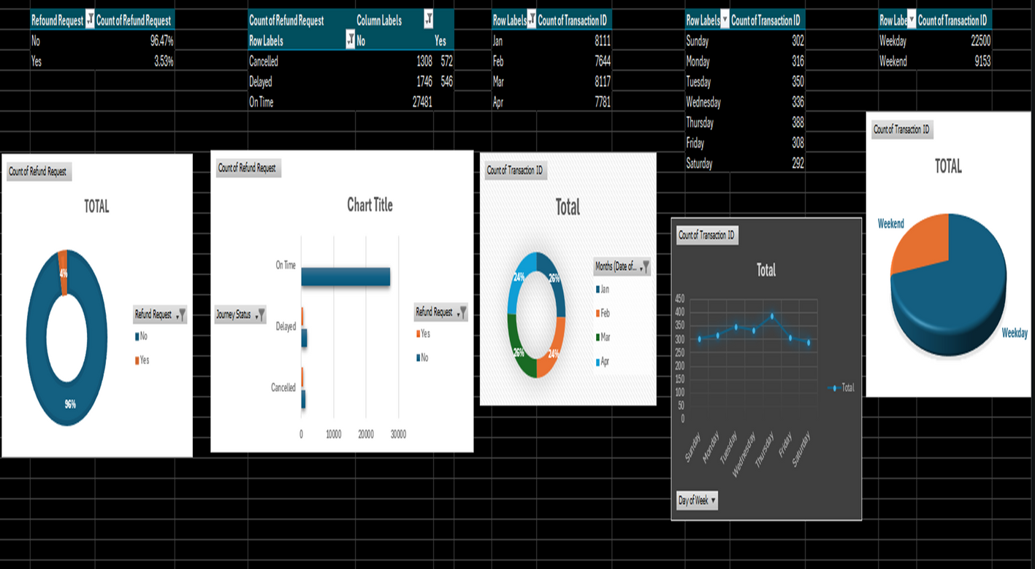
Exploratory Analysis
Initial exploration using Excel and Python revealed compelling trends, anomalies,and distributions within the data

Slide 14
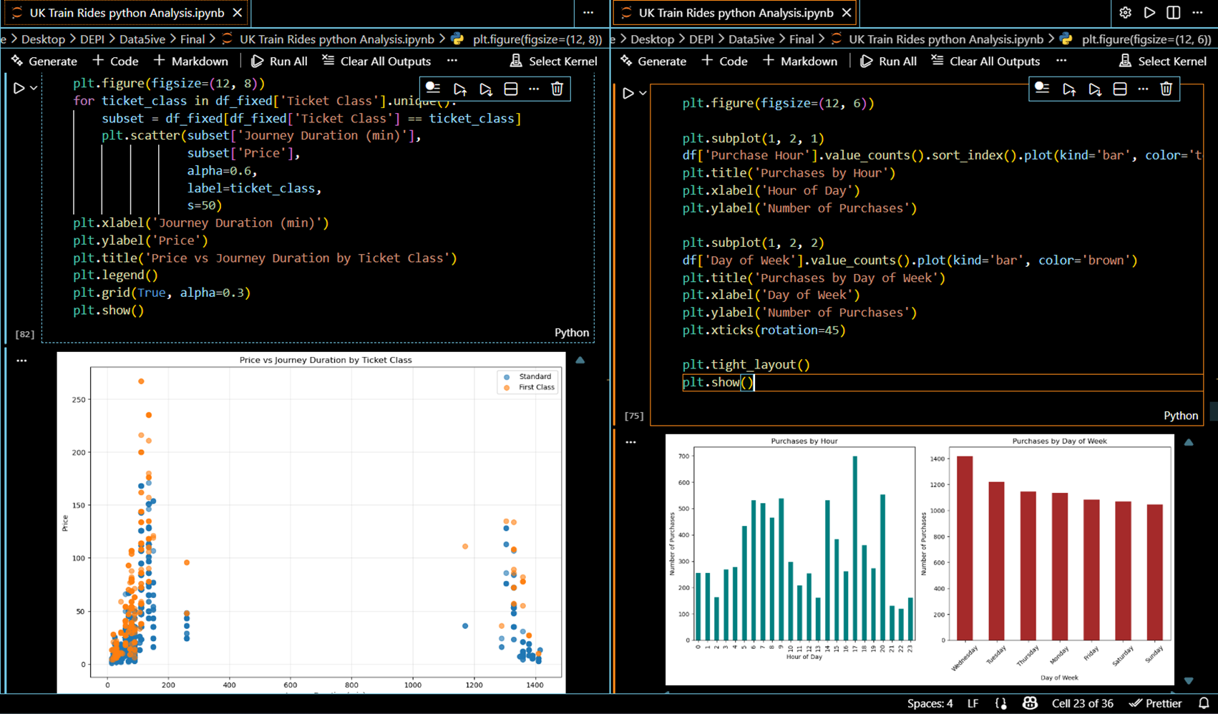
Exploratory Analysis
Python

Slide 15
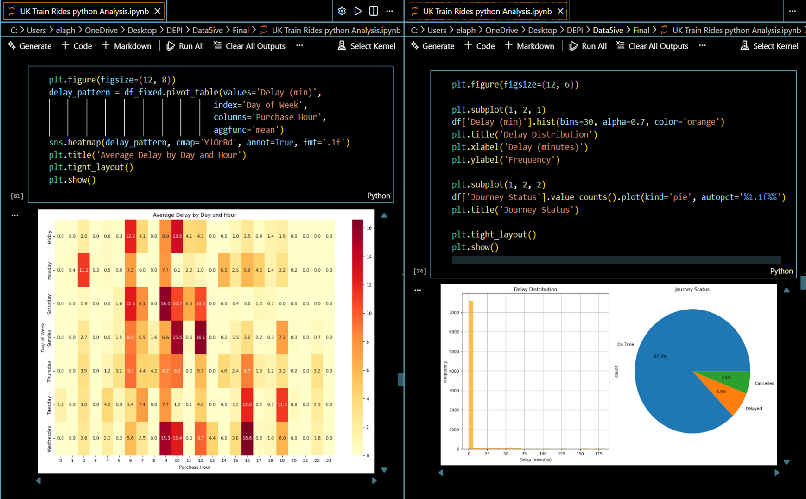
Exploratory Analysis

Slide 16
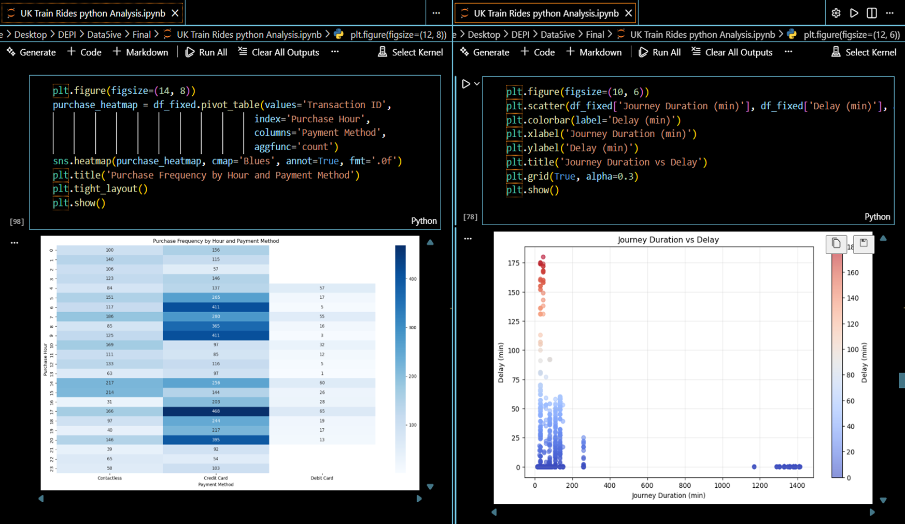
Exploratory Analysis

Slide 17
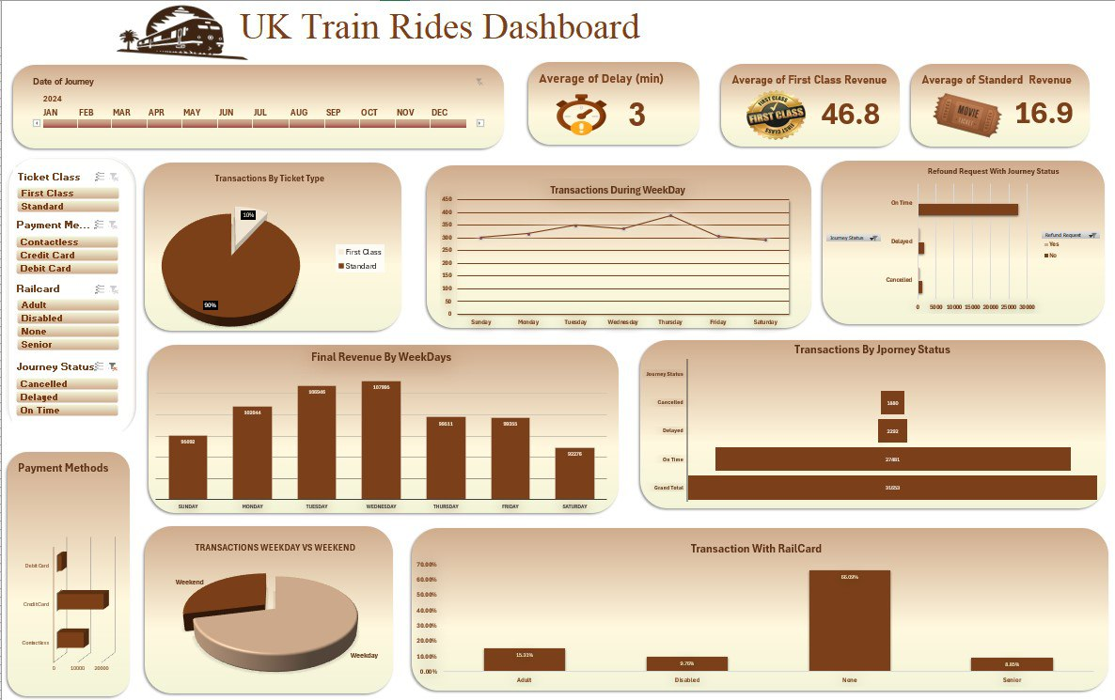
Excel Dashboard

Slide 18
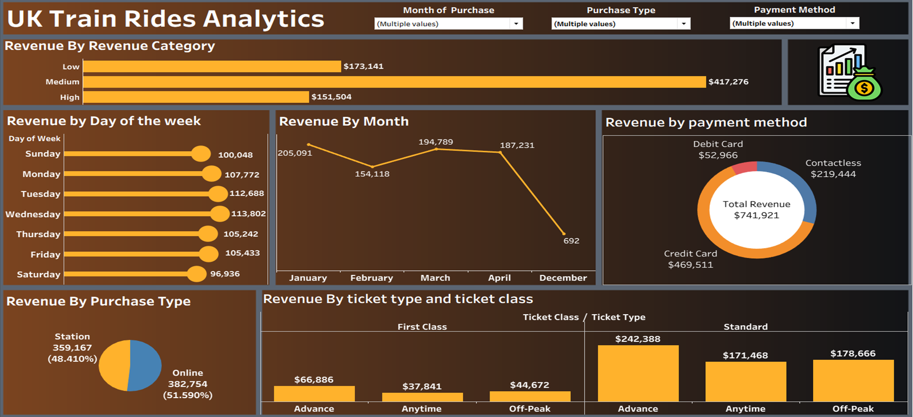
Tableau Visualizations
Why Tableau Added Value:
•Its advanced mapping features allowed for precise geographical analysis of delays and route performance.
•Interactive filters and drill-down options provided granular insights into specific journey segments.
•The ability to create complex, multi-layered dashboards enhanced the understanding of interconnected data points.

Slide 19
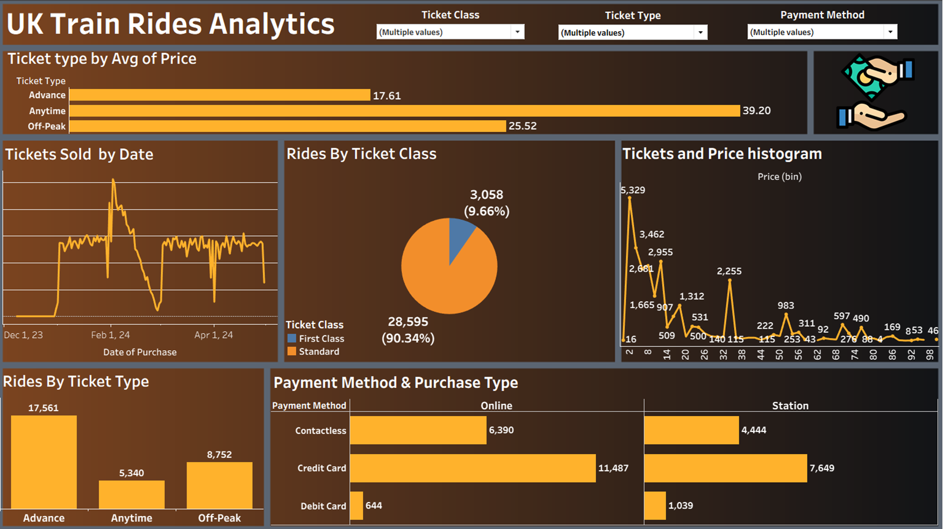
Tableau Visualizations

Slide 20
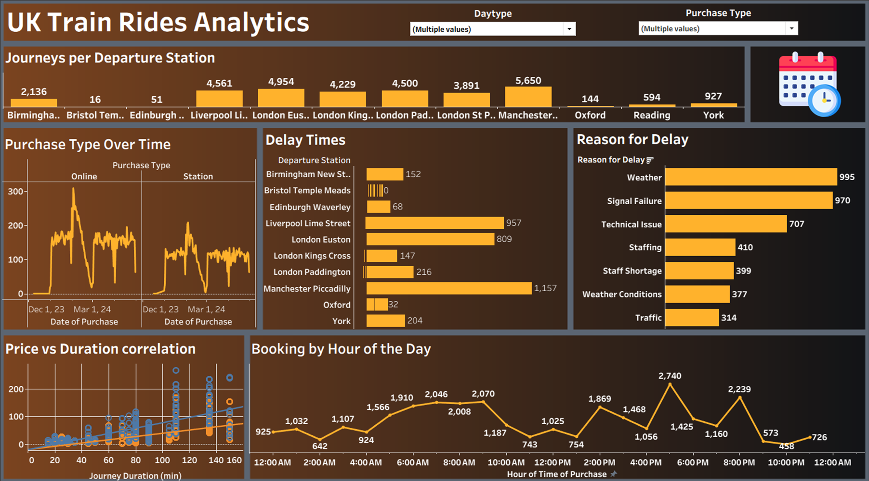
Tableau Visualizations

Slide 21

SQL Insights
Filtering
KPI Generation
Isolate relevant records and fields
Aggregation
Derive key performance indicators
Reporting
Data Extraction
Run SQL queries to pull raw data
Compute metrics and summarize results
Present KPIs for decision-making

Slide 22
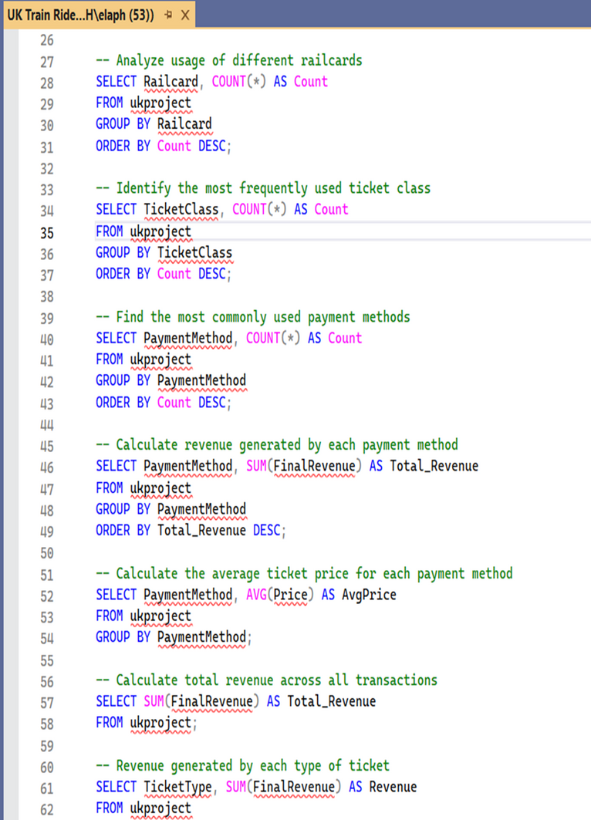
SQL Insights

Slide 23



Conclusion & Recommendations
Main Insights
Significant impact of peak hours on delays,
potential for increased online ticket sales, andimportance of proactive maintenance.
Suggested Actions
Implement dynamic scheduling during peak times, enhance digital ticketing platforms, and invest in predictive maintenance for critical routes.
Future Improvements
Integrate real-time data feeds, conduct passengersatisfaction surveys, and explore AIdriven forecasting models for demand and delays.

Slide 24
Thank
You

